Slide 1
Software Construction 3
00 - Course Intro

Slide 2
Teacher
Name: Constantin Alexandru Gheorghiasa (Alex)
Education:
MSc Software Development and Technology, Advanced Computing, ITU, Jan 2017(expected)
BA Software Development, KEA, Feb 2011 - Jan 2015
Web programmer, MMI, Aug 2006 - Aug 2007
High-School Mathematics - Computer Science, Sep 2004 - Jun 2008

Slide 3
Contact your Teacher
Email: coag@kea.dk
Skype: alexandru.gheorghiasa
Facebook: Alexandru Gheorghiasa

Slide 4
Time and Location
DAT15B
Mandag, Torsdag
08:30..11:45
Room
L37-1-B-16
DAT15I
Tuesday
08:30..11:00
Friday
08:30..13:15
Room
L37-0-A-07

Slide 5
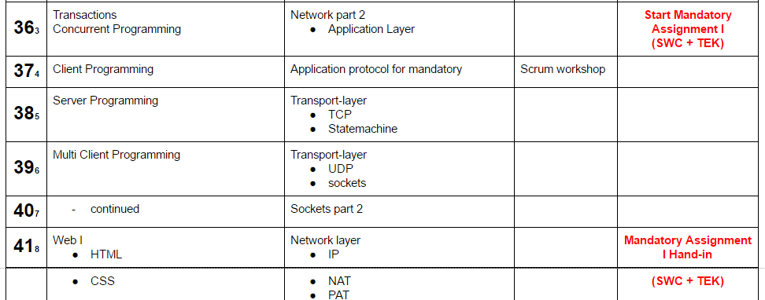
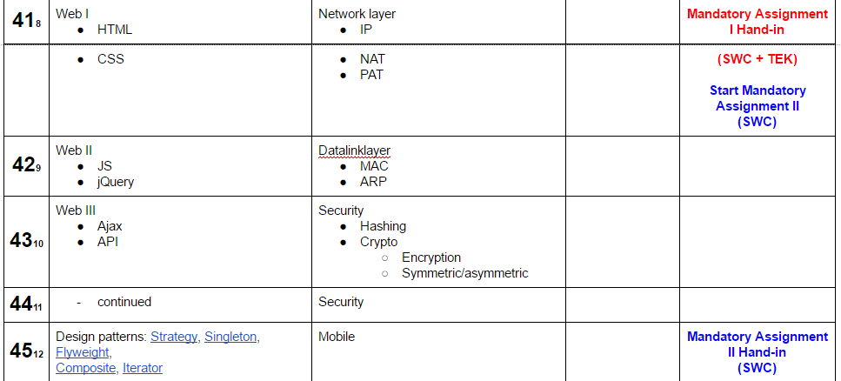
Assignments
2 mandatory assignments for SWC 3
MA1 SWC3 + TEK
MA2 is only SWC3
Mandatory assignments must be hand in on fronter by the deadline.
Mandatory assignments must be presented in front of your teacher by the deadline.
If you do not meet these requirements, you can not attend the exam and you will miss 1 of 3 exam attempts.

Slide 6
1/2
EN
Exam - Date: Week 1..3 2017
Prerequisites for being able to take the examination
The following prerequisites for being able to take the examination apply:
There are three compulsory participations associated with the examination. These are described on the Student Intranet, Fronter, in the semester's/class's space. Compulsory participations shall be submitted on the Student Intranet, Fronter, and are distributed as follows:
Key area Programming x 2
Key area Technology x 1
If one or more study activities are not satisfied, this means that the student may not participate in the examination, and that an examination attempt has been used.
Examination Preparation
The examination is an external individual oral examination and the assessment is based on the 7-grade scale.
The student receives a main question concerning Programming and a secondary question concerning Technology.
Main question concerning Programming:
A list of the main subjects concerning the area of programming will be published one week at the latest before the examination. The main subjects cover the most important subjects within the field and form the basis for the programming part of the examination. The student is expected to give a presentation of the programming subjects that are drawn. The presentation must cover both a submission of the theory and a review of practical programming examples.
Secondary question concerning Technology:
The main emphasis of the question applies to the subject "Computer Network and Distributed Systems".

Slide 7
2/2
EN
Exam - Date: Week 1..3 2017
The examination comprises 20 ECTS points.
The assessment is based on the 7-grade scale.
In the assessment, a weighting of 80 % will be given to the programming question, and 20 % to the secondary question.
A total of 40 minutes will be given per examinee, incl. voting.
Formal requirements for the written product
Not relevant.
Assessment criteria
The assessment criteria for the examination = the learning objectives for the compulsory course of study element: Programming and Technology, cf. the joint part of the curriculum.
Scheduling
The examination takes place at the end of the third semester. Further details about time and location are available on the Student Intranet, Fronter.
Examination Language
English.
Exam aids
None.

Slide 8
1/2
DK
Exam - Date: Week 1..3 2017
Forudsætninger for at gå til prøven
Følgende forudsætninger gælder for at gå til prøven:
Der er 3 deltagelsespligter knyttet til prøven. Disse er beskrevet på Fronter på semesterets/holdets rum. Deltagelsespligterne skal afleveres på Fronter og er fordelt således:
Kerneområde Programmering 2 stk.
Kerneområde Teknik 1 stk.
Ikke opfyldelse af blot én eller flere studieaktiviteter betyder, at den studerende ikke kan deltage i prøven, og at der er brugt et prøveforsøg.
Prøvens tilrettelæggelse
Prøven er en ekstern mundtlig individuel prøve og bedømmes efter 7-trinsskalaen.
Den studerende får udleveret et hovedspørgsmål indenfor Programmering samt bispørgsmål indenfor Teknologi.
Hovedspørgsmål Programmering:
Senest en uge inden prøven offentliggøres en liste af hovedemner inden for programmeringsområdet. Hovedemnerne omfatter de væsentligste emner inden for emneområdet og danner udgangspunkt for programmeringsdelen af prøven. Den studerende forventes at præsentere det trukne programmeringsemne. Præsentationen skal omfatte både en teoretisk fremlæggelse og en gennemgang af praktiske programmeringseksempler.
Bispørgsmål Teknologi:
Hovedvægten i spørgsmålet lægges på faget ”Computernetværk og distribuerede systemer”.

Slide 9
2/2
DK
Exam - Date: Week 1..3 2017
Prøvens omfang er 20 ECTS
Prøven bedømmes efter 7-trinsskalaen.
I bedømmelsen vægter programmeringsspørgsmålet 80 % og bispørgsmålet 20 %.
Der afsættes i alt 40 min. pr. eksaminand inkl. votering.
Formkrav til skriftligt produkt.
Ikke relevant.
Bedømmelseskriterier
Bedømmelseskriterierne er læringsmålet for prøven = Læringsmålene for det obligatorisk uddannelseselement: Programmering og Teknologi, jf. den fælles del af studieordningen.
Tidsmæssig placering
Prøven placeres ved udgangen af 3. semester. Nærmere oplysning om tid og sted findes på Studenter Intranet Fronter.
Prøvens sprog
Dansk.
Hjælpemidler
Ingen.

Slide 10
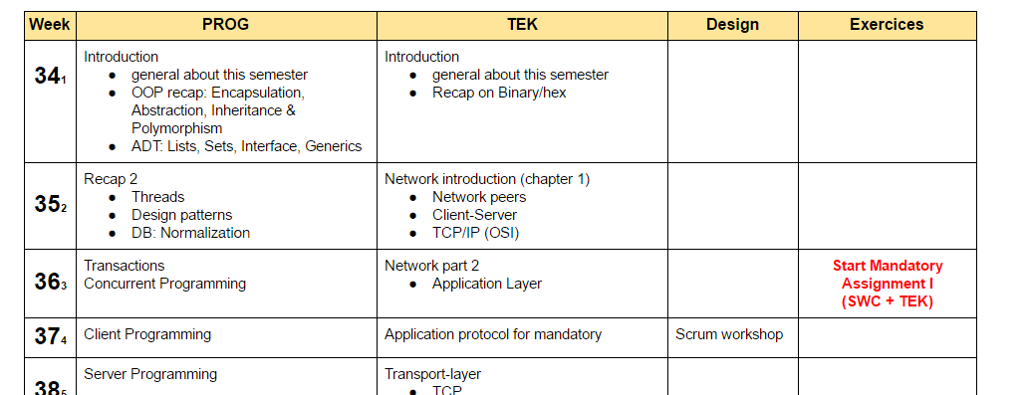
Study Plan
https://docs.google.com/document/d/1SU3UaXoBT_TfZsHnAC9J83iuwqKDqDg1ZYoPMrLWdh0/edit?usp=sharing

Slide 11
Books / Literature
NO Books
Chapters from some books
Online sources

Slide 12
Tools
IDEs
IntelliJ IDEA
WebStorm
PhpStorm
Version Control
git
Web stack
ampps
Web browser
Google Chrome
Mozilla Firefox

Slide 13
Questions

